Slide 1
EBGN645: Day 5

Slide 2
Questions, notes
I’d like to do my project on X.. What do you think?
I can’t get ‘gams’ to run on my Mac
Things I want you to have on your resume:
HPC experience
GitHub basics
Optimization modeling

Slide 3
Proposal submission [will also send via email]
To submit your proposal (due at the beginning of class 9/24), you will need to:
Create a github repository, named [your last name]_EBGN645
Create a subdirectory: Project
In Project – save your proposal document as
[your last name]_proposal.[pdf/docx/…]
Commit then push
Either (a) make the repository public or (b) add me as a collaborator
If (b): My GitHub username is: maxxb77
Email me the link, even if you’ve invited me as a collaborator

Slide 4
Bigger picture: Comp econ projects
Most of you have been exposed to econometrics
There: estimating parameters based on historical data
Here: simulating new situations/policies/conditions/..
Often using the results from econometric studies
Anything from math/micro can be modeled:
Social surplus maximization
Profit maximization or cost minimization
Utility maximization (cobb-dougy) s.t. budget constraints
…

Slide 5
Econometrics vs Computational – framing
Econometrics | Computational | Tool
Has a carbon tax reduced coal plant generation? | What is the least-cost generation mix under different carbon tax levels? | Linear program
Have states’ renewable portfolio standards (RPS) policies increased renewable generation? | How do different rules related to RP Spolicies impact system costs and emissions in 2050? | Capacity expansion model
Have safety regulations decreased the profitability of mining iron ore? | How might the US iron ore sector respond to new tariffs? | Market equilibrium model (NLP)

Slide 6
Econometrics vs Computational – framing [2]
Econometrics | Computational | Tool
Does increased natural gas supply reduce electricity prices? | How does new gas capacity change marginal prices and dispatch patterns across hours? | Cost minimization or equilibrium power market model
How has GDP growth affectd electricity demand? | How could sectoral growth shift electricity demand, fuel substitution, and emissions across the whole economy? | CGE model
Does higher gasoline price reduce vehicle miles traveled? | How could fuel price changes shift transport mode choice between petroleum and electricity? | Partial or general equilibrium
Does EV purchase subsidy increase electric vehicle adoption? | What is the optimal fleet mix (gasoline vs. EV) under different subsidy and fuel price scenarios when households minimize lifetime cost of travel? | Discrete choice + system optimization

Slide 7
Econometrics vs Computational – framing [MB]
Econometrics | Computational
How has the power sector responded to mineral price changes? | What is the impact of doubling the price of minerals on the US power sector evolution?
How has pollution impacted people near coal plants? | What is the impact of federal policies on future deaths from air pollution?
How have lithium producers responded to Chinese price control? | How would a new entrant impact the global lithium markets? What is the DWL from Chinese lithium market control?
How has the electricity grid responded to industrial procurement of clean energy credits? | What is the impact of different (hypothetical and real) clean procurement mechanisms on the US power grid?

Slide 8
Takeaway – proposal discussion
Econometrics asks: what can we learn from what has happened?
Computational asks: how might markets/consumers/producers/… respond given a hypothetical situation?
Often looking at policy…
Environmental policies
New regulations
Tariffs
Or market conditions:
Technological evolution
New resource discovery

Slide 9
Agenda
Practicing GAMS/GitHub
(Very) Simple examples
Introducing time
(slightly) less simple example, introduction of conditionals
Restarts/saves

Slide 10
Ripley’s restaurant – A very simple model
Ripley works 40 hours per week making hamburgers, hot dogs, and french fries. The net revenue and time to make for each of the items is in the table below.
What is Ripley’s profit-maximizing production choice?
Item | Revenue | Cost | Hours
Hamburger | 1.5 | 0.75 | 0.5
Hot dog | 0.75 | 0.1 | 0.2
French fries | 0.25 | 0.05 | 0.1

Slide 11
Ripley’s restaurant
Warning.. The images I’m about to show are disturbing

Slide 12

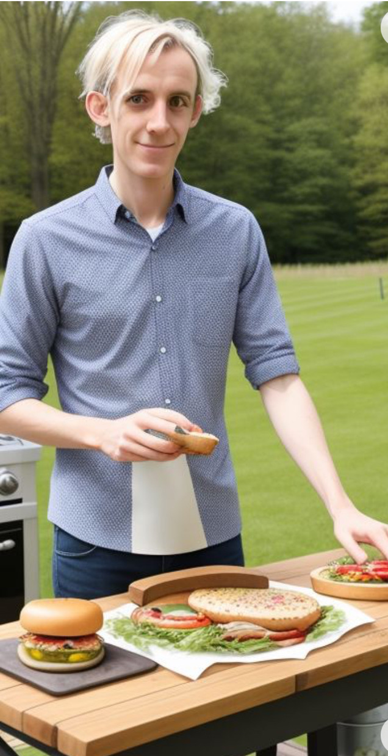
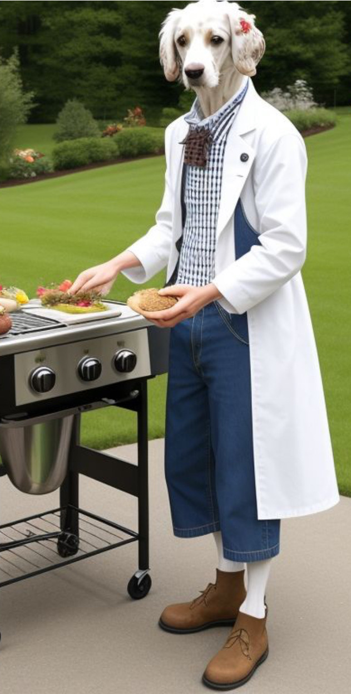
Ripley’s restaurant – visualized by (janky) AI

Slide 13
Writing a model
Always go in this order:
Sets/indices
Parameters
Variables
Objective function
Constraints
See explanation/examples in INFORMS (Grievel et al.) or CCS papers

Slide 14
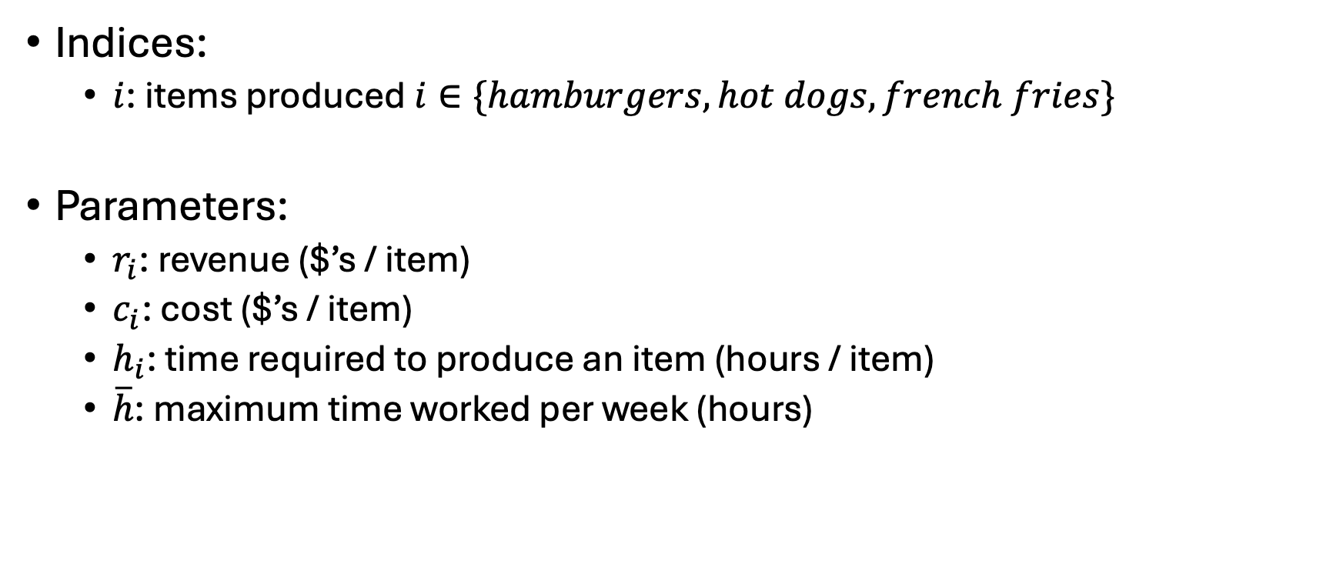
Ripley’s restaurant
Indices:
$i$: items produced $i∈\{hamburgers, hot dogs, french fries\}$
Parameters:
$r_{i}$: revenue ($’s / item)
$c_{i}$: cost ($’s / item)
$h_{i}$: time required to produce an item (hours / item)
$\overline{h}$: maximum time worked per week (hours)
Item | Revenue | Cost | Hours
Hamburger | 1.5 | 0.75 | 0.5
Hot dog | 0.75 | 0.1 | 0.2
French fries | 0.25 | 0.05 | 0.1

Slide 15
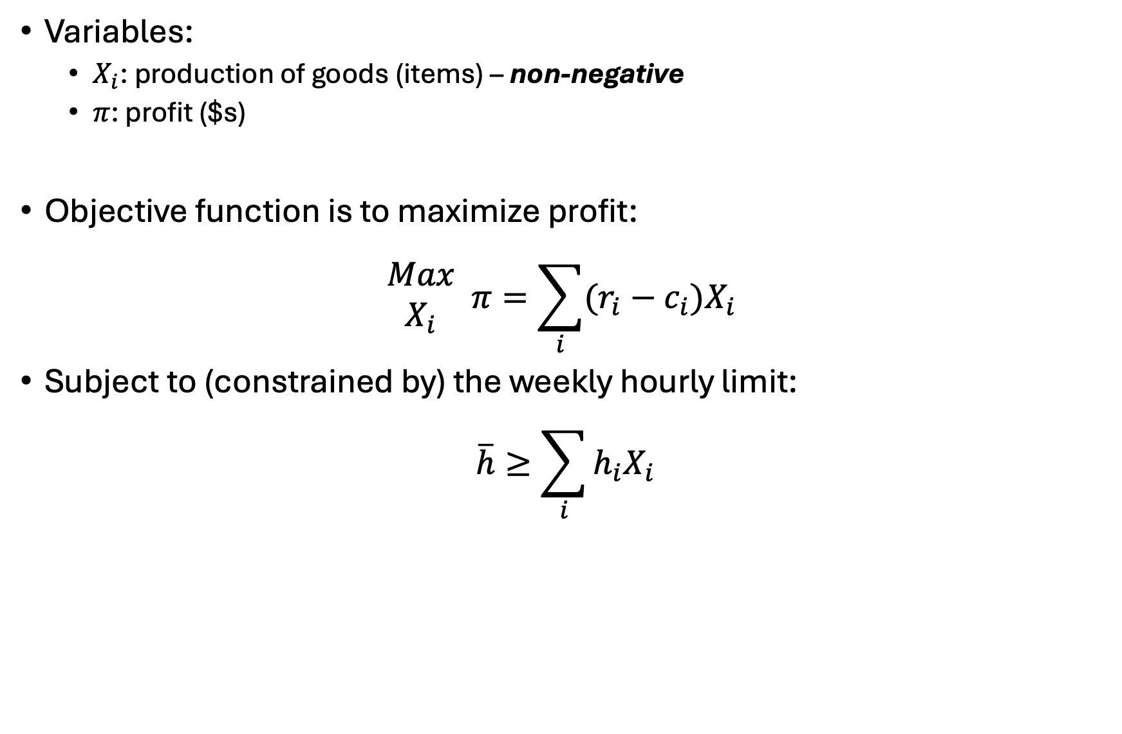
Ripley’s restaurant
Variables:
$X_{i}$: production of goods (items) – non-negative
$π$: profit ($s)
Objective function is to maximize profit:
$$\begin{matrix}Max \\ X_{i}\end{matrix} π=\sum_{i}{(r_{i}−c_{i})X_{i}}$$
Subject to (constrained by) the weekly hourly limit:
$$\overline{h}≥\sum_{i}{h_{i}X_{i}}$$

Slide 16
Ripley’s restaurant
Let’s code this up in GAMS…

Slide 17
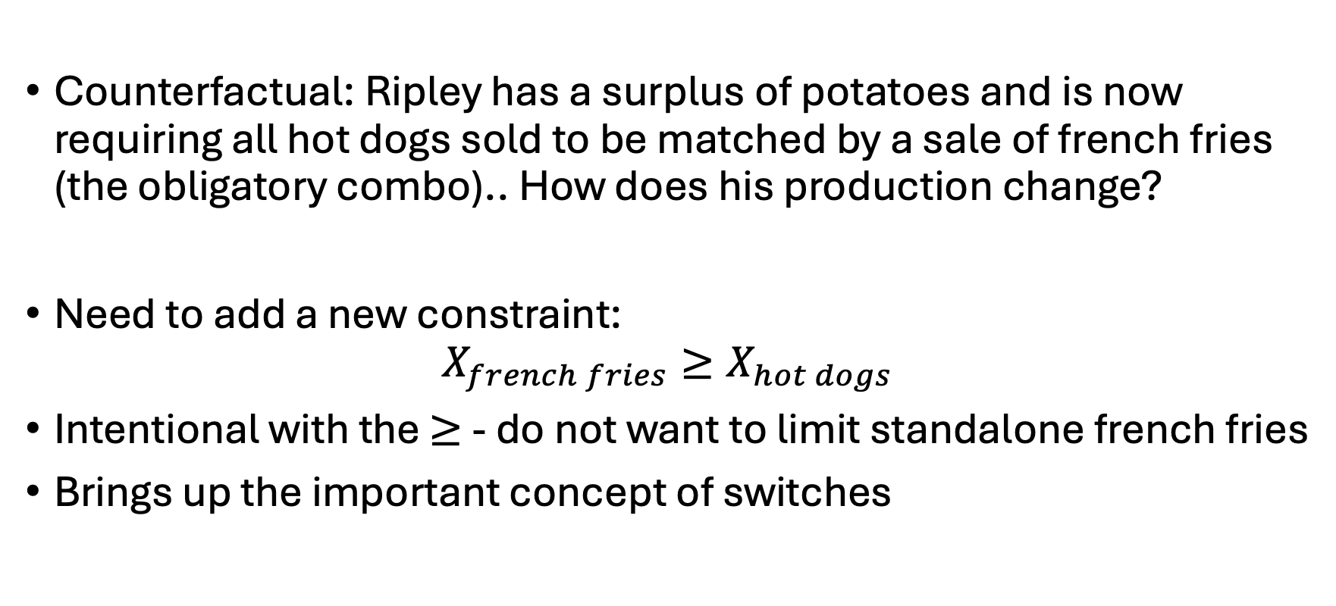
Ripley’s restaurant
Counterfactual: Ripley has a surplus of potatoes and is now requiring all hot dogs sold to be matched by a sale of french fries (the obligatory combo).. How does his production change?
Need to add a new constraint:
$$X_{french fries}≥X_{hot dogs}$$
Intentional with the $≥$ - do not want to limit standalone french fries
Brings up the important concept of switches

Slide 18
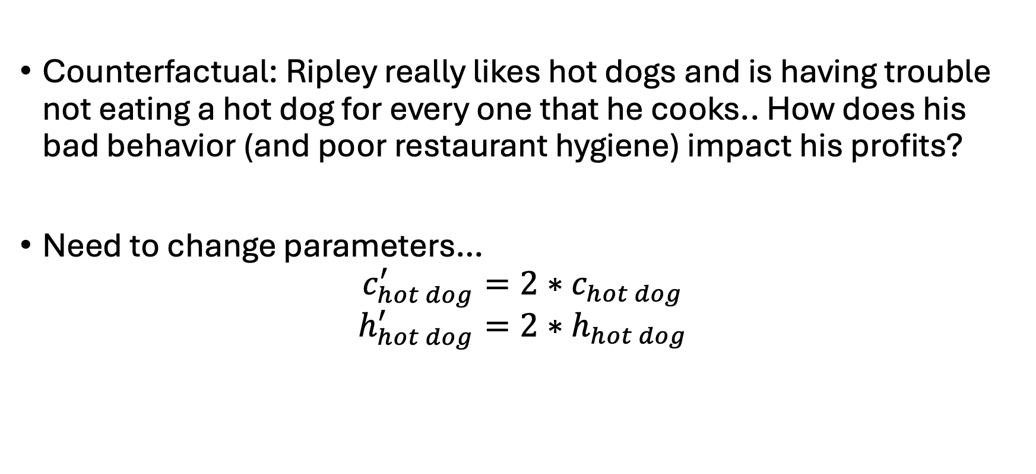
Ripley’s restaurant
Counterfactual: Ripley really likes hot dogs and is having trouble not eating a hot dog for every one that he cooks.. How does his bad behavior (and poor restaurant hygiene) impact his profits?
Need to change parameters…
$$c_{hot dog}^{′}=2∗c_{hot dog}$$
$$h_{hot dog}^{′}=2∗h_{hot dog}$$

Slide 19
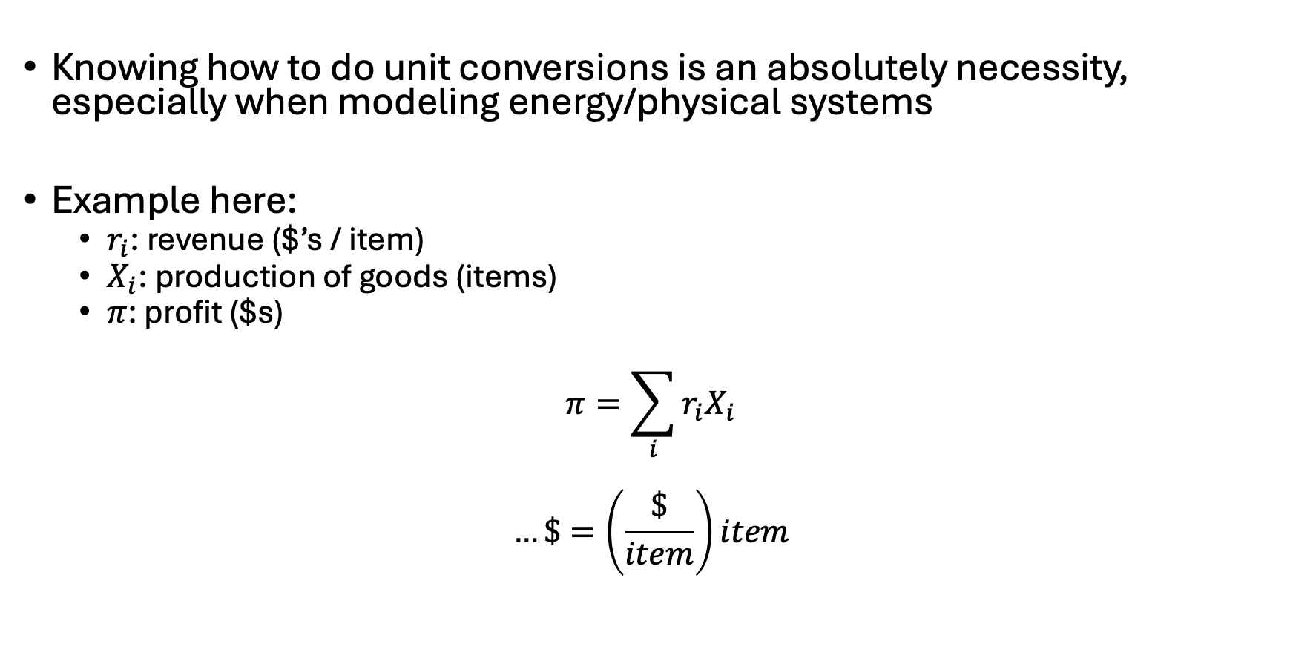
Notes on unit conversions
Knowing how to do unit conversions is an absolutely necessity, especially when modeling energy/physical systems
Example here:
$r_{i}$: revenue ($’s / item)
$X_{i}$: production of goods (items)
$π$: profit ($s)
$$π=\sum_{i}{{r_{i}X}_{i}}$$
$$…\$=\left(\frac{\$}{item}\right)item$$

Slide 20
Sparse matrix construction

Slide 21

Example 2: Ursula’s Utility
Ursula love’s eating pizza and beer. She is at Woody’s and is trying to decide what combination would maximize her utility/happiness. She has $20 in her pocket and forgot her wallet (luckily she’s a regular and they don’t ID her). Each piece of pizza costs $2 and gives her 2 utils of satisfaction while each beer costs $4 and gives her 5 utils of satisfaction. What is Ursula’s utility-maximizing set of consumption choices?
Also – what major utility assumption are we violating?

Slide 22
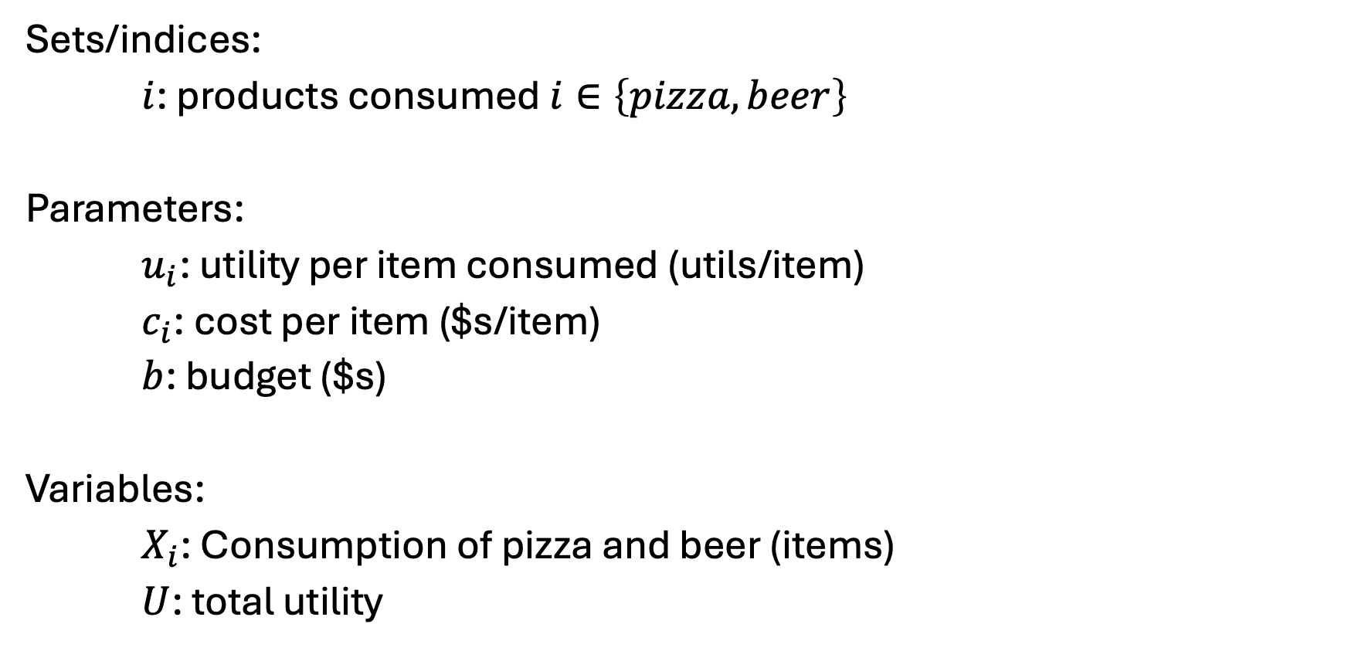
Ursula’s Utility [I] – Sets, parameters, variables
Sets/indices:
$i$: products consumed $i∈\left\{pizza, beer\right\}$
Parameters:
$u_{i}$: utility per item consumed (utils/item)
$c_{i}$: cost per item ($s/item)
$b$: budget ($s)
Variables:
$X_{i}$: Consumption of pizza and beer (items)
$U$: total utility

Slide 23
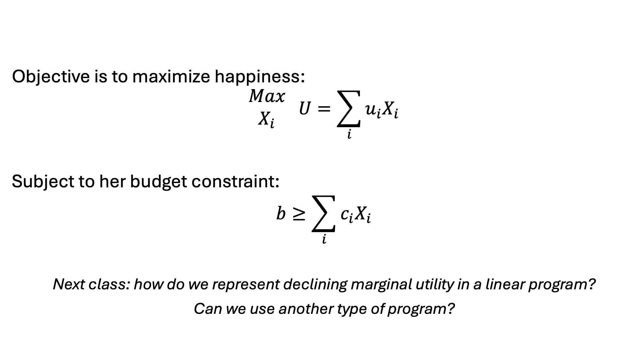
Ursula’s Utility [II] – Objective and constraints
Objective is to maximize happiness:
$$\begin{matrix}Max \\ X_{i}\end{matrix} U=\sum_{i}{u_{i}X_{i}}$$
Subject to her budget constraint:
$$b≥\sum_{i}{c_{i}X_{i}}$$
Next class: how do we represent declining marginal utility in a linear program?
Can we use another type of program?

Slide 24

Example 3: Franz Forestry
Franz owns land that produces lumber. Franz makes $100 net profit for every tree cut down. There is an initial stand of 100 trees and the trees grow at 1%* per year. Franz has a discount rate of 2%*. What is Franz profit-maximizing harvesting behavior?
*: Varied in counterfactuals

Slide 25

Franz Forestry [I] – sets and parameters
Set/Indices:
$t$: years, $t∈\{0,1,2,…T\}$
$t^{0}$: first year
$T$: last year
Parameters:
$p$: sale price ($/tree)
$g$: annual growth rate for trees (%) – $g≥1$
$s^{0}$: initial stock of trees (trees)
$r$: discount rate (%)
$δ_{t}$: discount factor (unitless)
$$δ_{t}=\frac{1}{{\left(1+r\right)}^{t}}$$

Slide 26
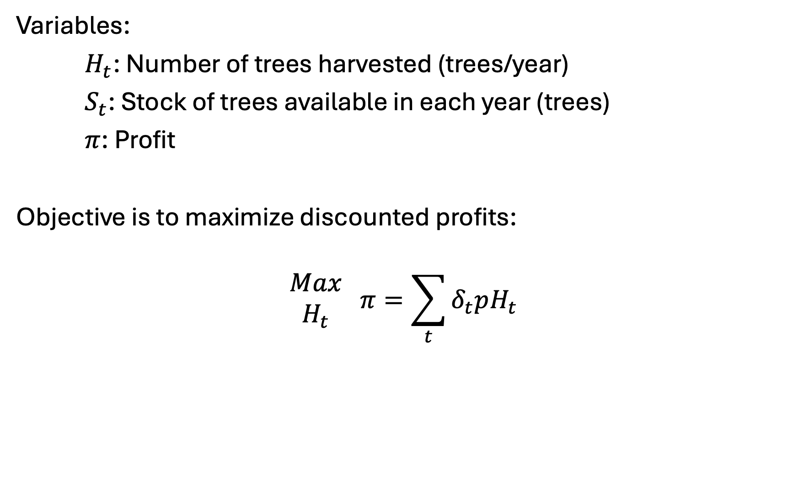
Franz Forestry [II] – variables and objective
Variables:
$H_{t}$: Number of trees harvested (trees/year)
$S_{t}$: Stock of trees available in each year (trees)
$π$: Profit
Objective is to maximize discounted profits:
$$\begin{matrix}Max \\ H_{t}\end{matrix} π=\sum_{t}{δ_{t}pH_{t}}$$

Slide 27
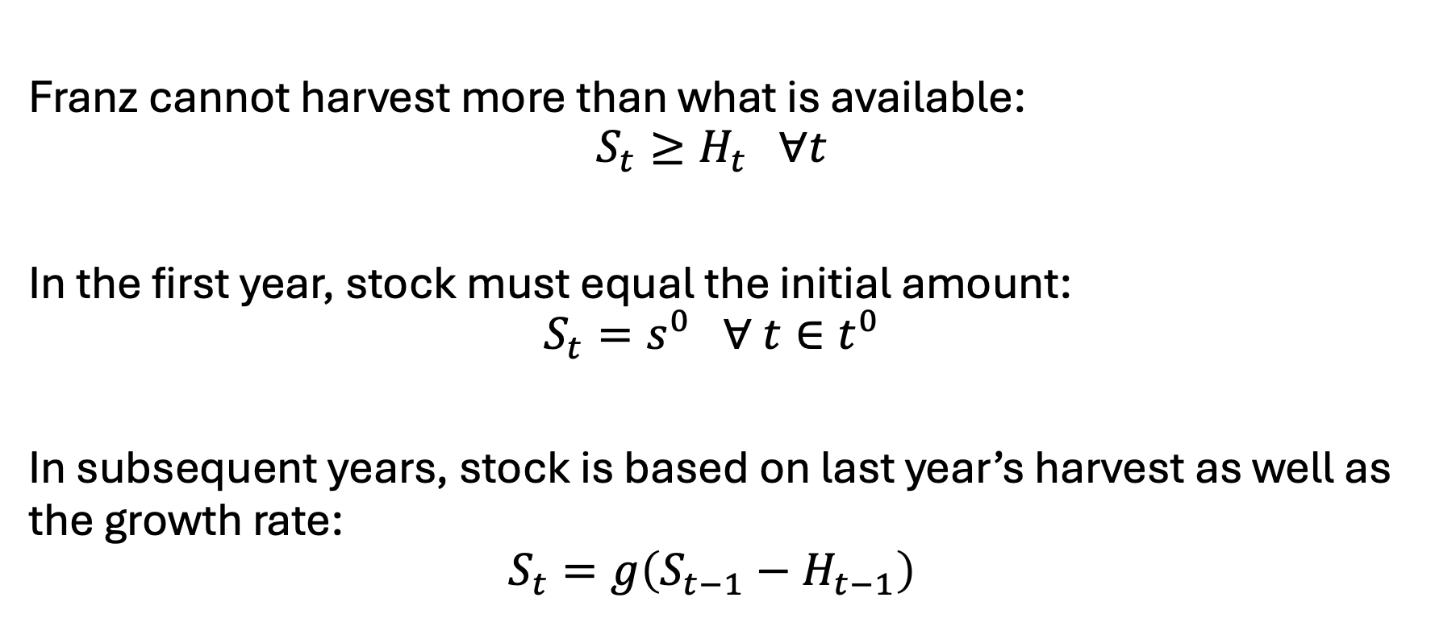
Franz Forestry [III] - constraints
Franz cannot harvest more than what is available:
$$S_{t}≥H_{t} ∀t$$
In the first year, stock must equal the initial amount:
$$S_{t}=s^{0} ∀ t∈t^{0}$$
In subsequent years, stock is based on last year’s harvest as well as the growth rate:
$$S_{t}=g\left(S_{t−1}−H_{t−1}\right)$$

Slide 28
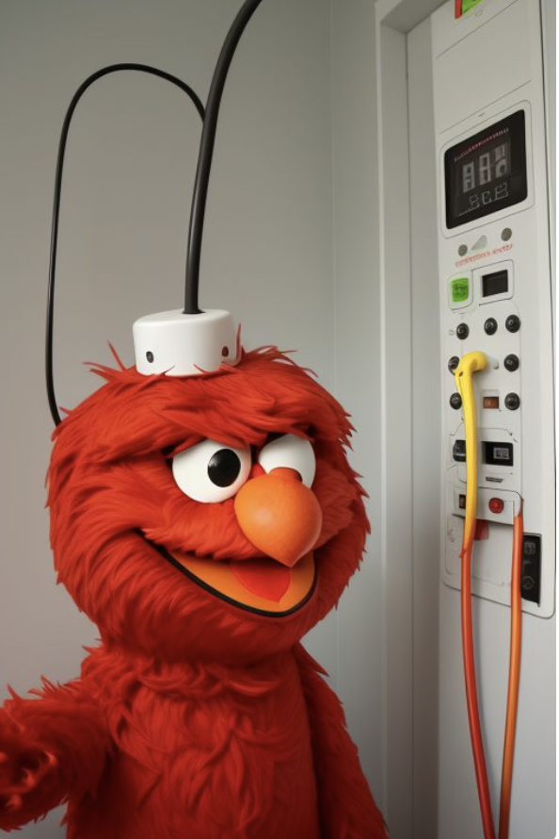
Example 4: Elmo’s Electricity
Elmo runs a small electricity utility. He has three electricity facilities: coal, gas, and wind. Each technology has its own cost and capacity. He must meet the hourly demand of his small town. What is Elmo’s cost-minimizing set of operational decisions?

Slide 29
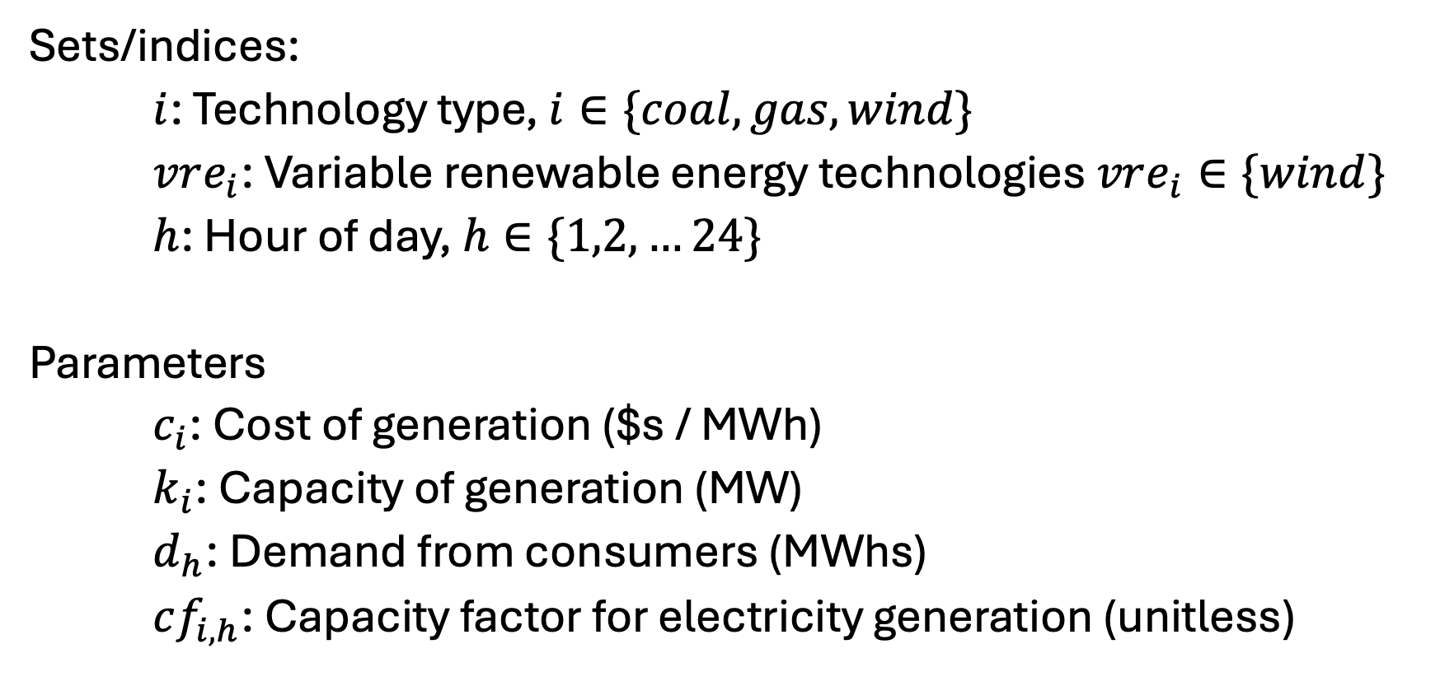
Elmo’s Electricity [I] – Sets and parameters
Sets/indices:
$i$: Technology type, $i∈\{coal, gas, wind\}$
$vre_{i}$: Variable renewable energy technologies $vre_{i}∈\{wind\}$
$h$: Hour of day, $h∈\{1,2,…24\}$
Parameters
$c_{i}$: Cost of generation ($s / MWh)
$k_{i}$: Capacity of generation (MW)
$d_{h}$: Demand from consumers (MWhs)
$cf_{i,h}$: Capacity factor for electricity generation (unitless)

Slide 30
Elmo’s electricity [II] - data
See spreadsheet - EBGN645_Data_Day3.xlsx

Slide 31
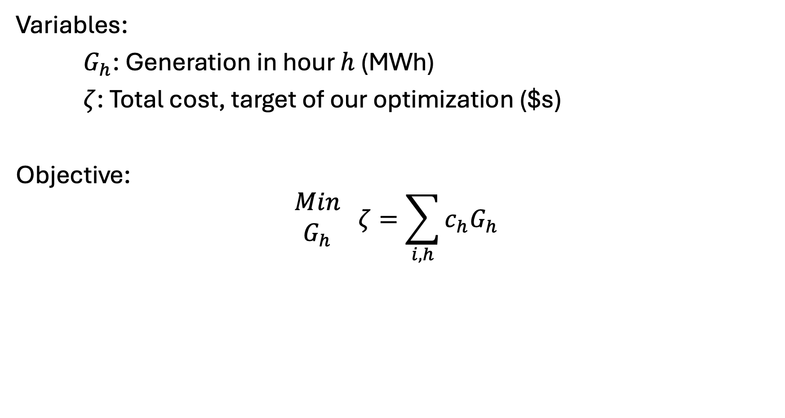
Elmo’s Electricity [III] – Variables and objective
Variables:
$G_{h}$: Generation in hour $h$ (MWh)
$ζ$: Total cost, target of our optimization ($s)
Objective:
$$\begin{matrix}Min \\ G_{h}\end{matrix} ζ=\sum_{i,h}{c_{h}G_{h}}$$

Slide 32
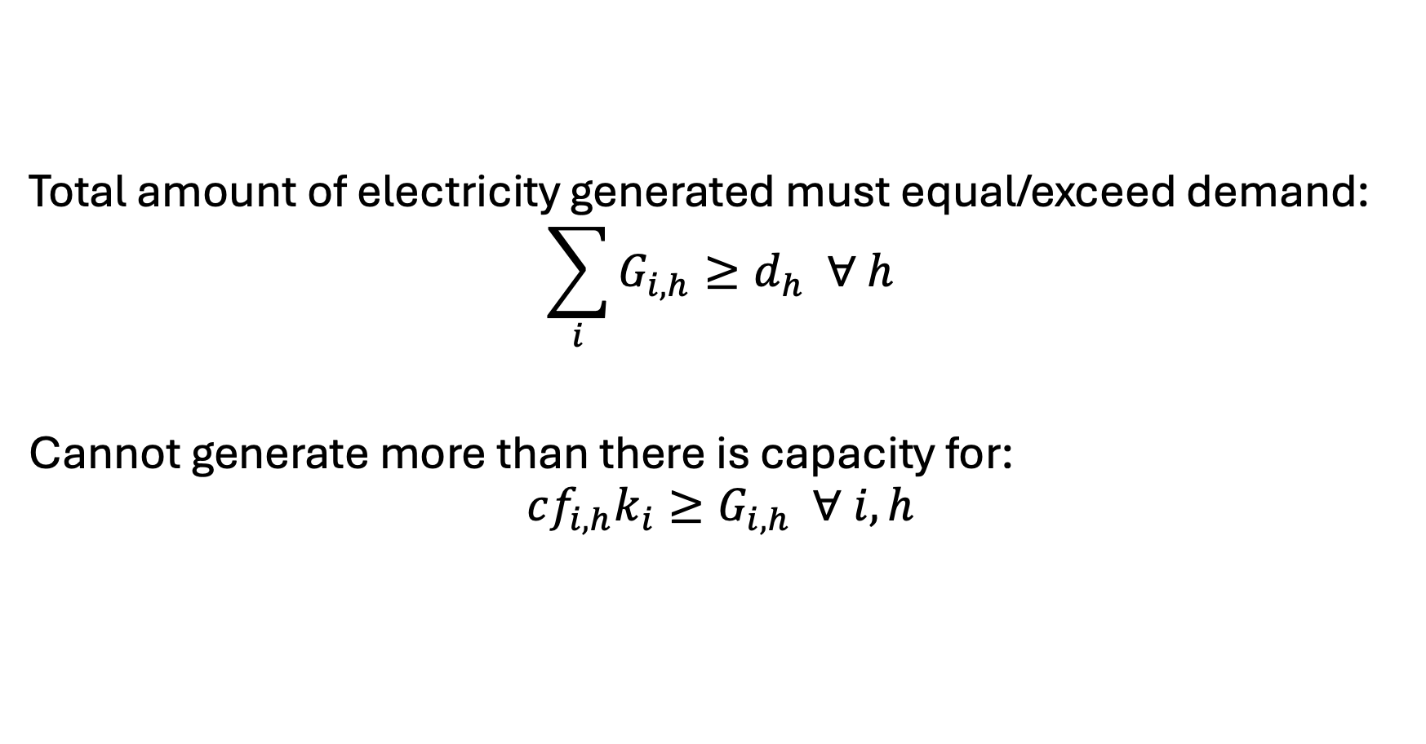
Elmo’s Electricity [IV] - Constraints
Total amount of electricity generated must equal/exceed demand:
$$\sum_{i}{G_{i,h}}≥d_{h} ∀ h$$
Cannot generate more than there is capacity for:
$$cf_{i,h}k_{i}≥G_{i,h} ∀ i,h$$

